Slide 1

Fragment & Animation 字节跳动Android工程师-魏君成

Slide 2
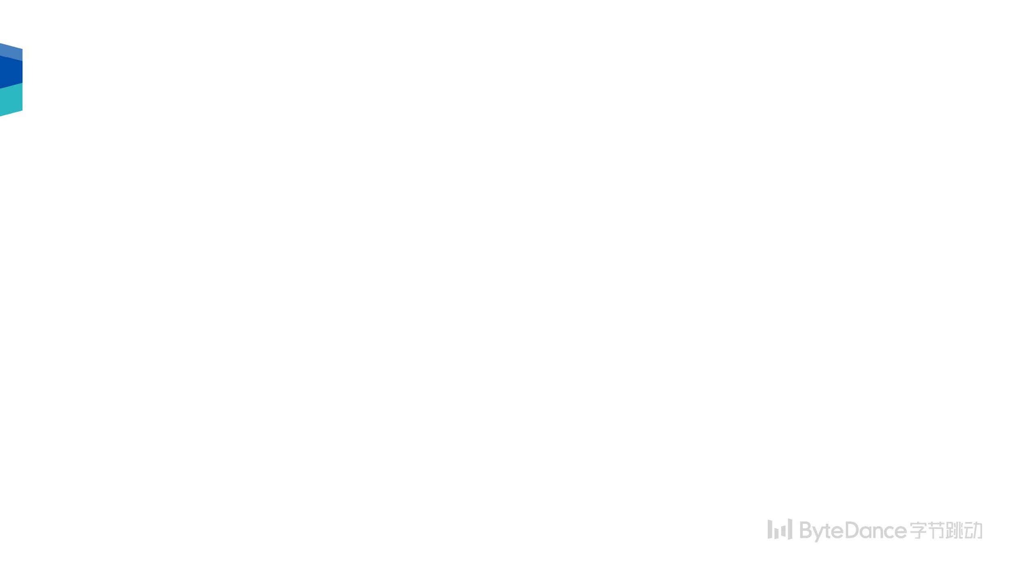
目录
为什么使用fragment
生命周期
如何动态添加
如何和 Fragment/Activity 通信

Slide 3
Fragment
app components, mini-activity
可重用 UI 单元

Slide 4
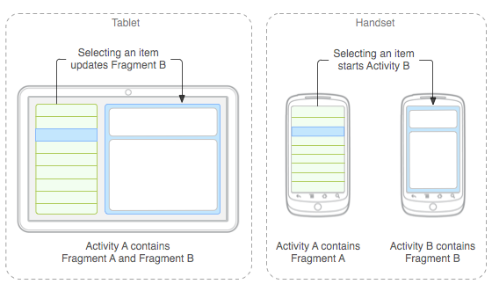
Fragment - UI 重用
Notes:
android 可以运行在多种尺寸的设备上，手机、平板、电视、手表等，不同尺寸的屏幕会有不同的展现形式，即便在同一个设备上，也会有横竖屏的不同展示需求。在工程上，希望能够有更多的界面复用

Slide 5
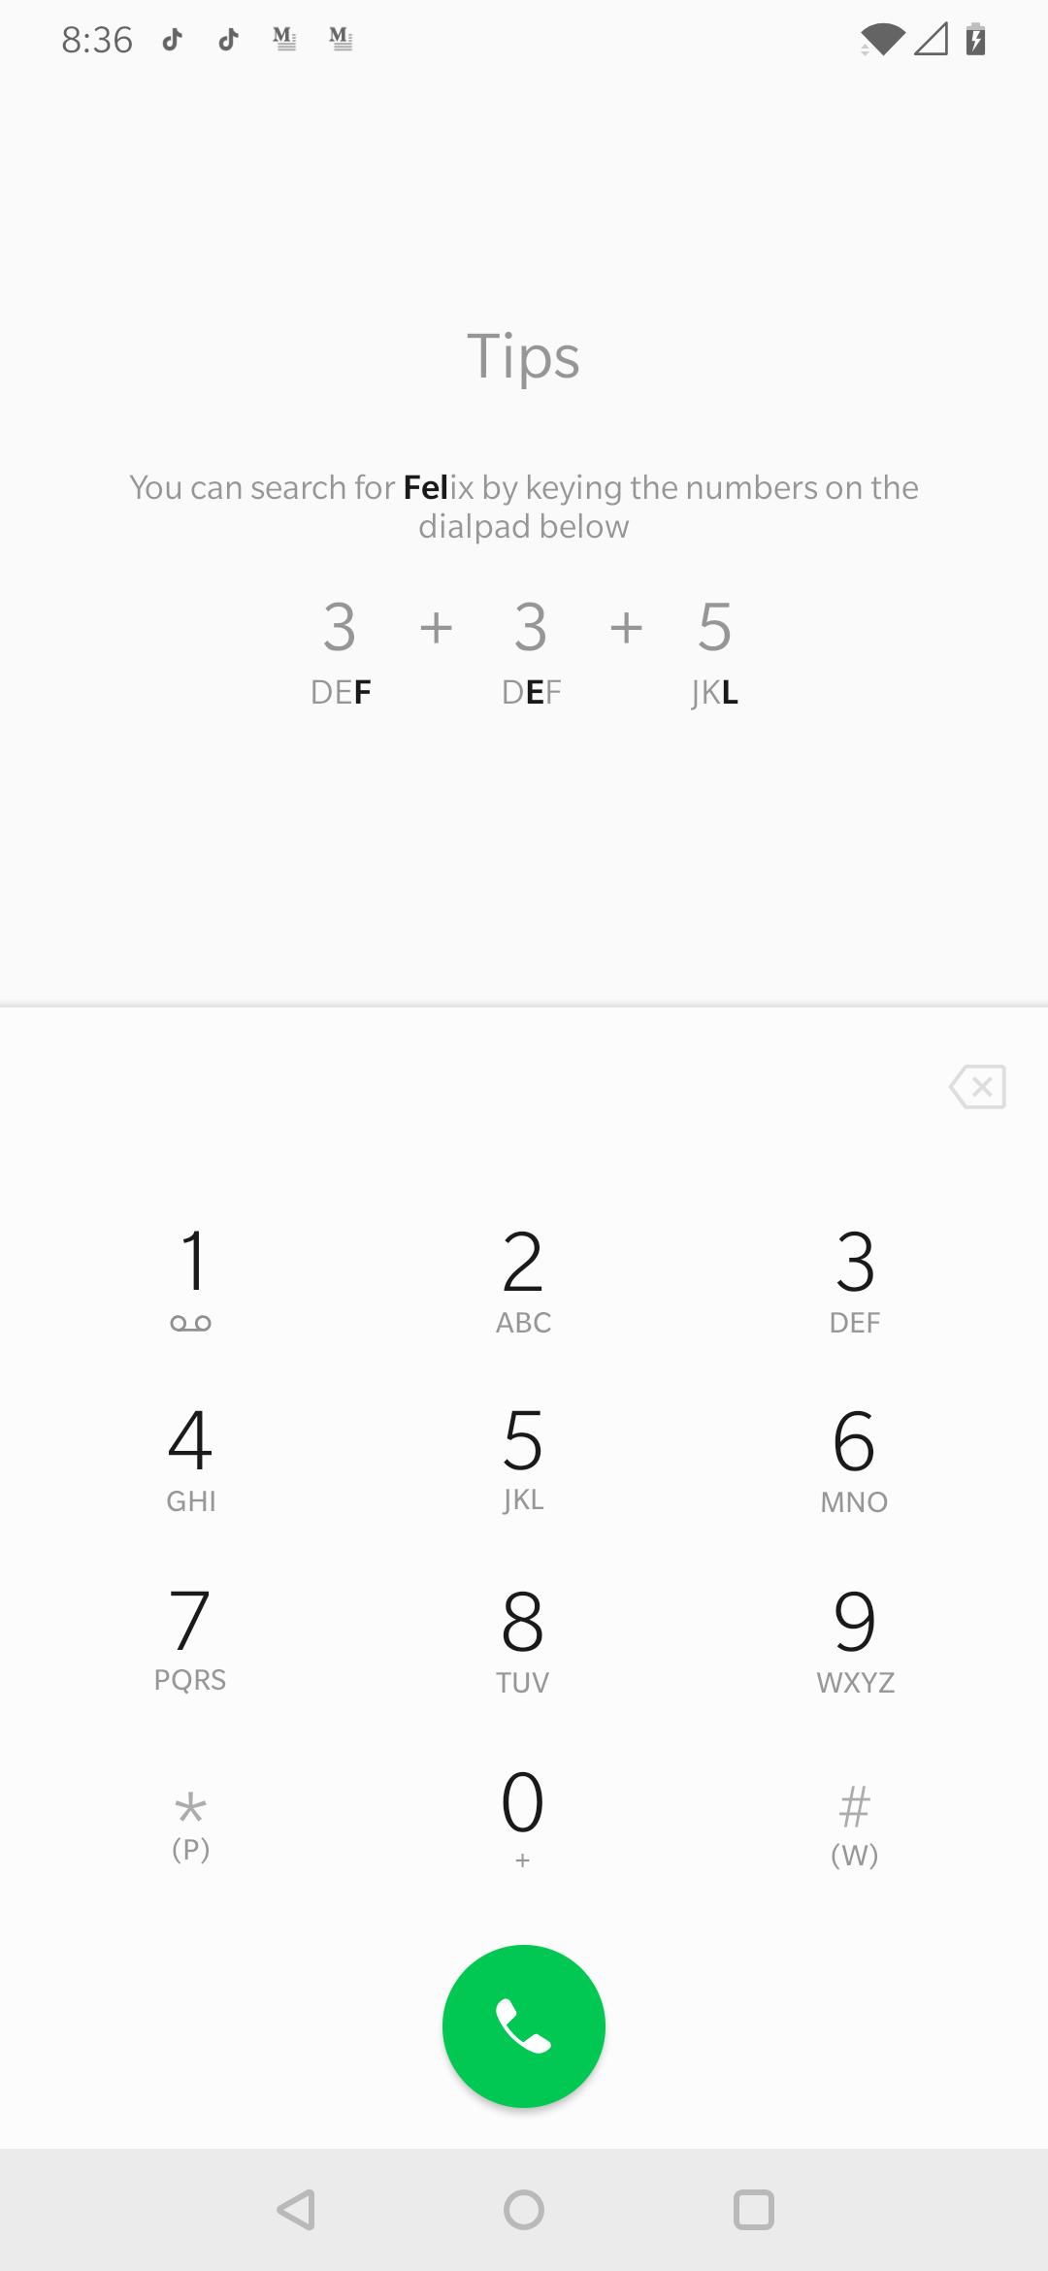
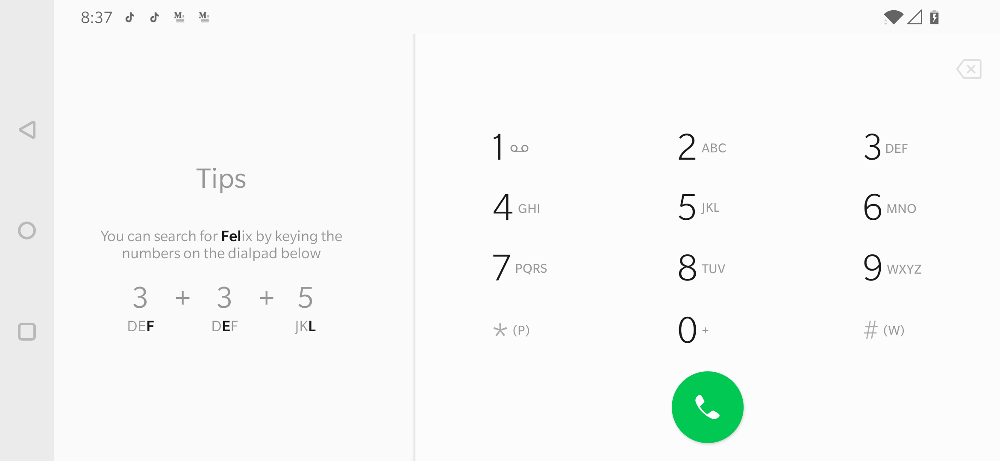
Fragment - Responsive Design (响应式设计)

Slide 6
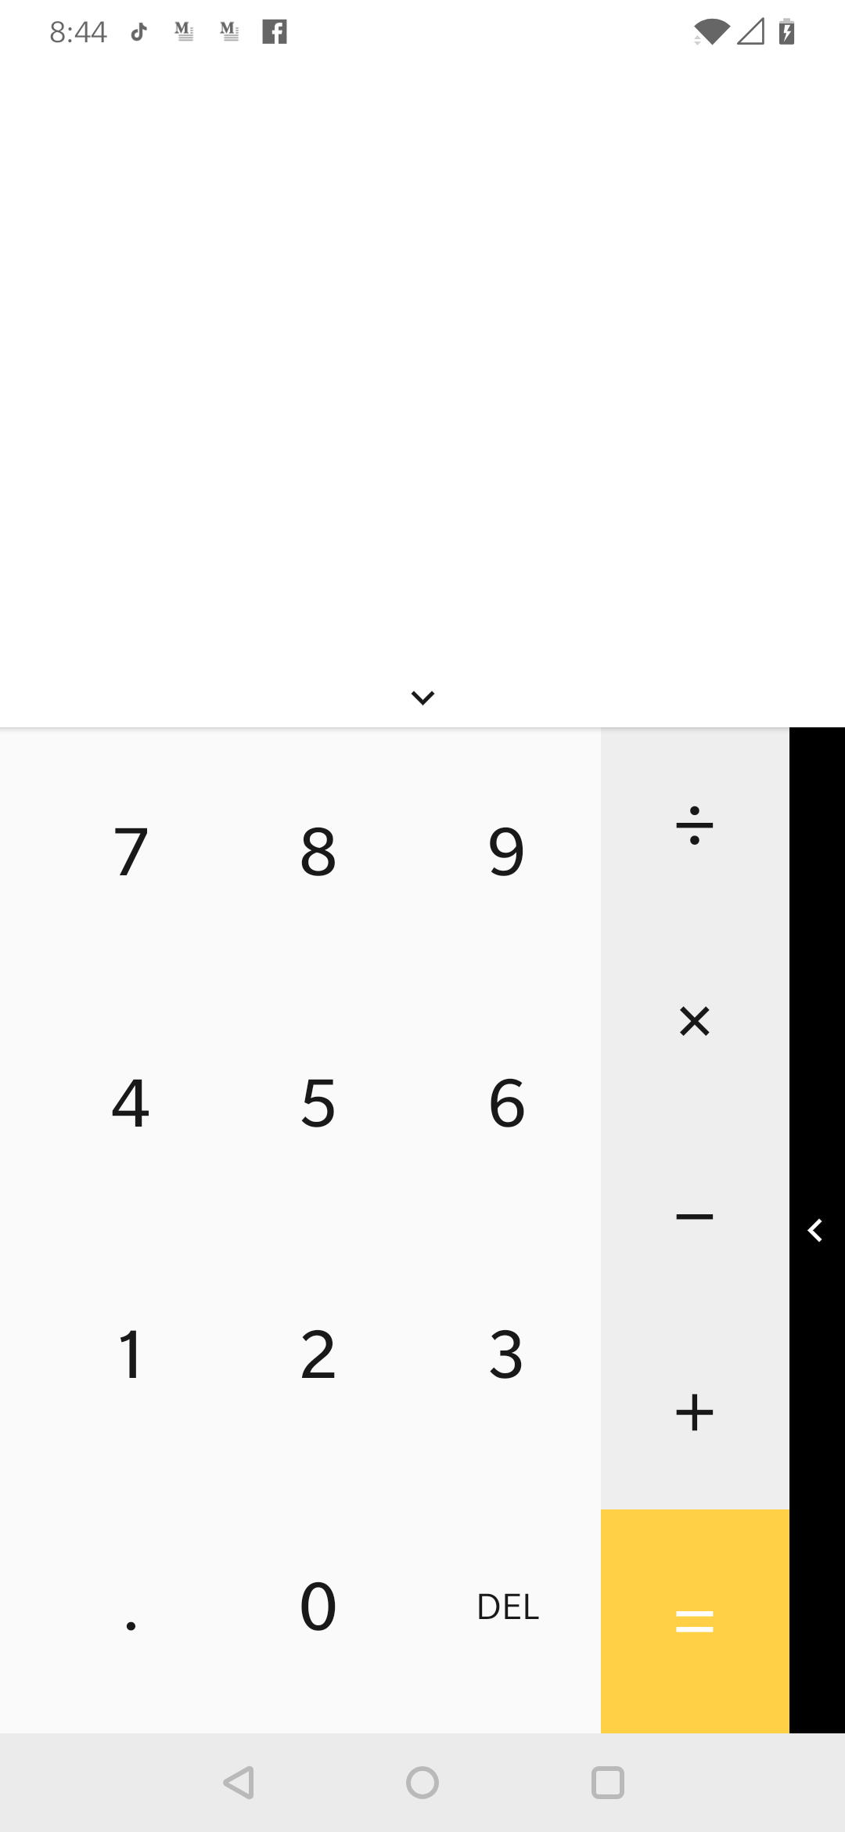
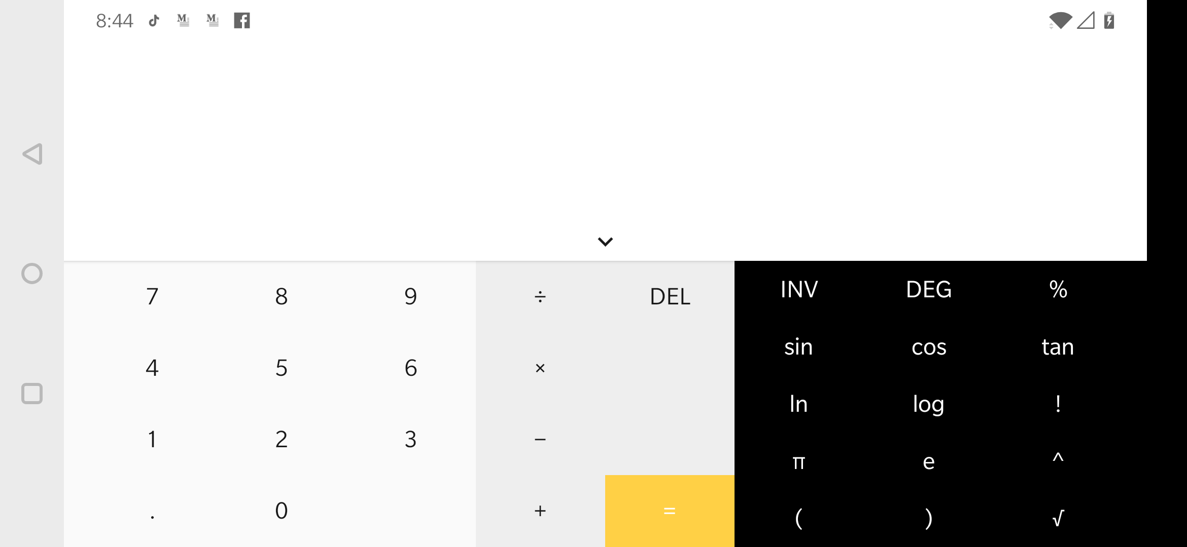
Fragment - Responsive Design
页面的设计与开发应当根据用户行为以及设备环境(系统平台、屏幕尺寸 、屏幕定向等)进行相应的响应和调整

Slide 7
Why Fragment
Activity 模块化
相比 View，带有生命周期管理
可重用，灵活
可以动态添加和删除

Slide 8
Which Fragment
android.support.v4.app.Fragment(3.0下版本)
android.app.Fragment
在各个版本的系统中行为都一致

Slide 9
How to use Fragment
Example: ViewPager+Fragment

Slide 10
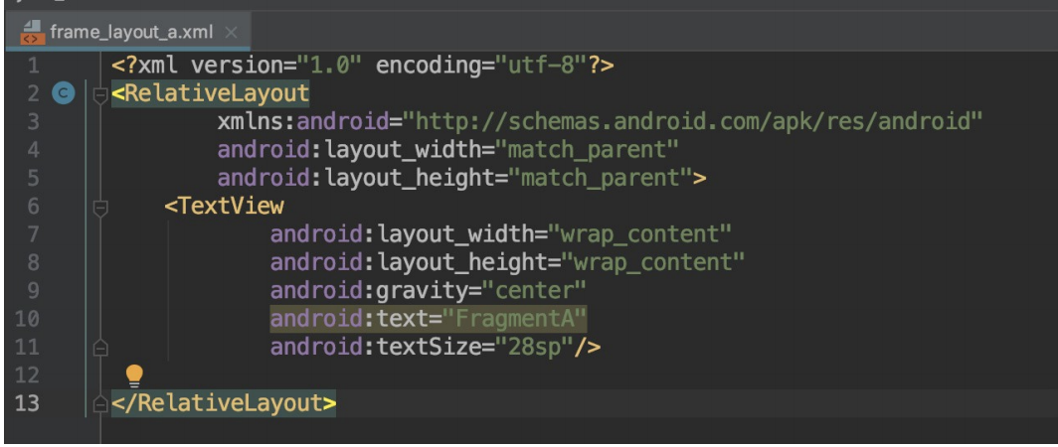
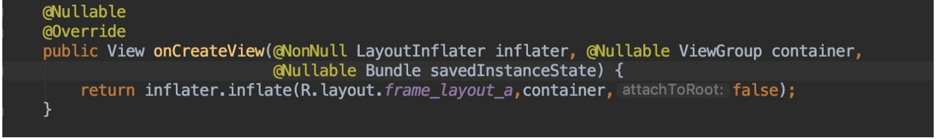
一个fragmen的简单示例
定义 fragment 布局文件
定义 fragment 类

Slide 11
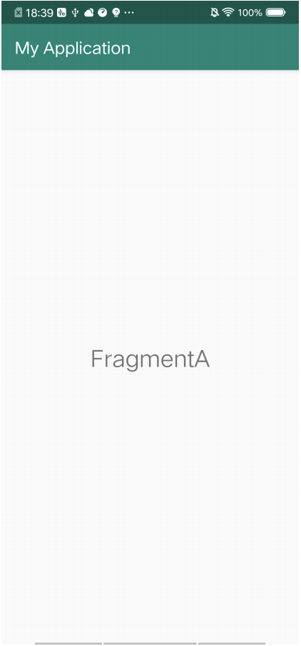
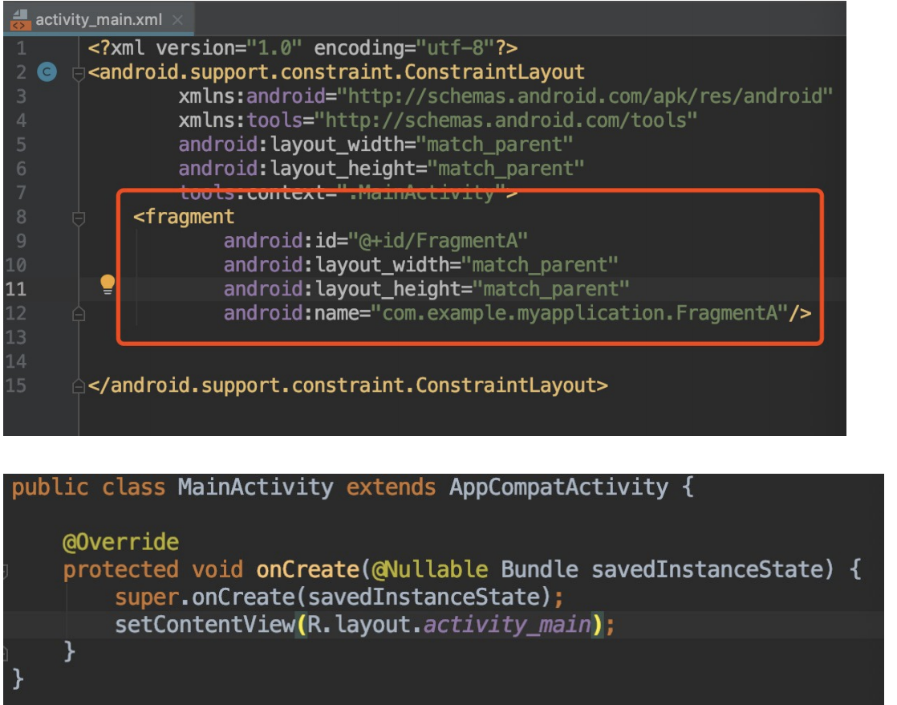
一个fragmen的简单示例
在 activity 布局文件中嵌入 fragment

Slide 12
动态添加/删除 Fragment
FragmentManager
动态添加/删除/替换 Fragment
FragmentTransaction
Fragment 容器
定义 Fragment 的位置和大小

Slide 13
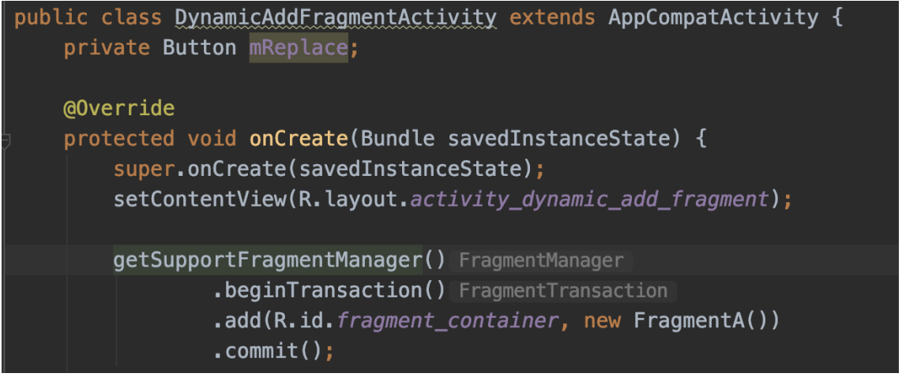
动态添加/删除 Fragment
programmatically add the fragment to an existing ViewGroup
FragmentManager & FragmentTransaction

Slide 14
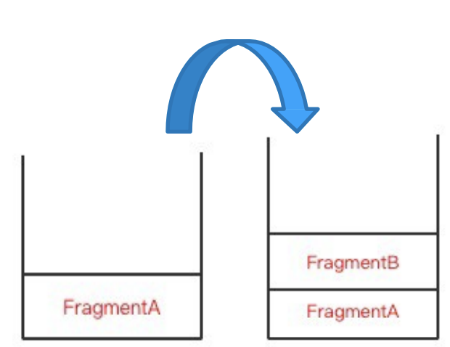
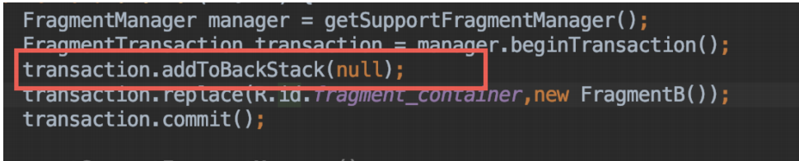
How to use: Performing Fragment Transactions
addToBackStack/popBackStack

Slide 15
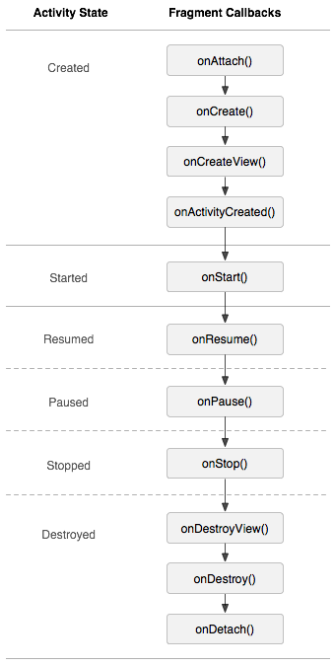
生命周期
onAttach/onDetach
onCreate/onDestroy
onCreateView/onDestroyView
onActivityCreated
onStart/onStop
onResume/onPause

Slide 16
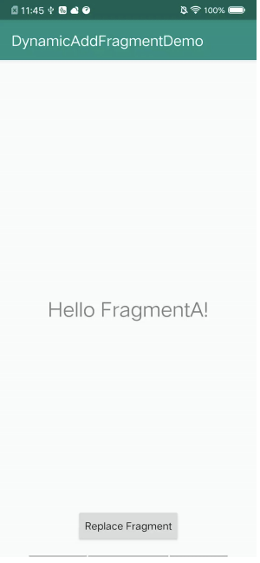
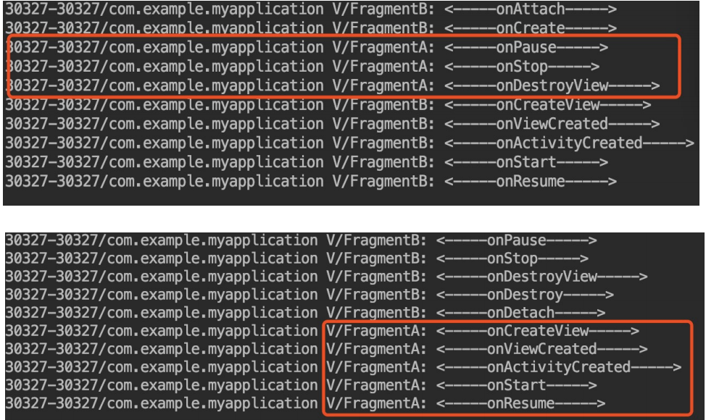
How to use: Performing Fragment Transactions
addToBackStack/popBackStack

Slide 17
Fragment/Activity 之间的通信
如何构造带参数的 Fragment
通过接口和回调

Slide 18
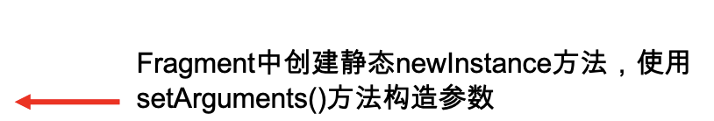
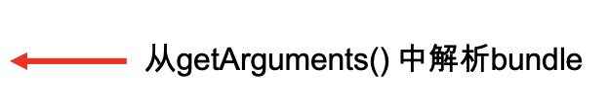
示例 - Communications - Arguments
public class StaticColorFragment extends Fragment { private static final String KEY_COLOR = "key_color"; public static StaticColorFragment newFragment(int color) { StaticColorFragment fragment = new StaticColorFragment(); Bundle args = new Bundle(); args.putInt(KEY_COLOR, color); fragment.setArguments(args); return fragment; } public View onCreateView(...) { int color = Color.CYAN; Bundle args = getArguments(); if (args != null) { color = args.getInt(KEY_COLOR, Color.CYAN); } View view = new View(inflater.getContext()); view.setBackgroundColor(color); return view; } }
Notes:
这里的例子准备顺便简单说下如何引用外部开源库, f2/DynamicColorFragmentActivity

Slide 19
示例 - Communications - Listeners & Setter
public class DynamicColorFragmentActivity extends AppCompatActivity implements OnColorSelectListener {
... @Override public void onAttachFragment(Fragment fragment) { super.onAttachFragment(fragment); if (fragment instanceof DynamicColorSelectorFragment) { ((DynamicColorSelectorFragment) fragment).setOnColorSelectListener(this); //Activity监听fragment } }
@Override public void onColorSelect(@ColorInt int color) { Fragment f = getSupportFragmentManager().findFragmentById(R.id.color_fragment_container); if (f instanceof DynamicColorFragment) { ((DynamicColorFragment) f).updateColor(color); //Activity设置fragment对象属性
} } }
Notes:
f2/DynamicColorFragmentActivity

Slide 20
示例 - Master Detail
Portrait
Master Activity: Item List
Detail Activity: Item Detail
Landscape
One Activity: List & Detail
Notes:
f1，注意打开自动旋转

Slide 21
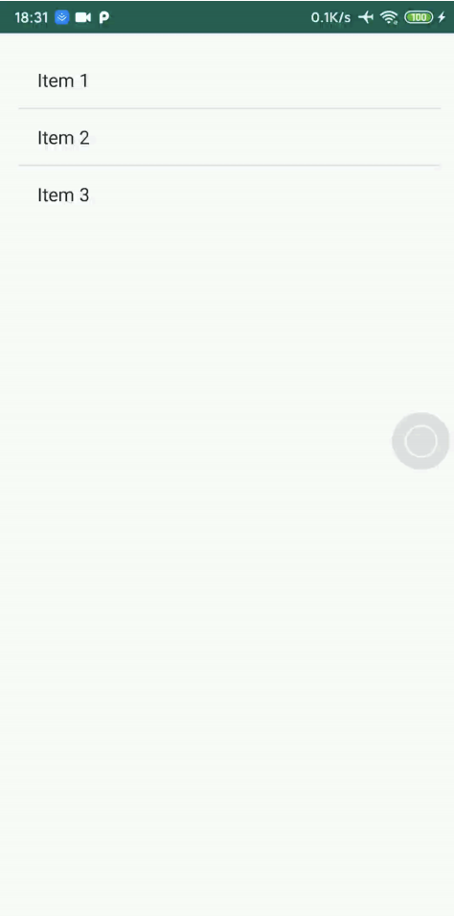
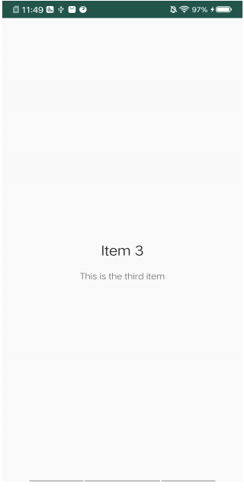
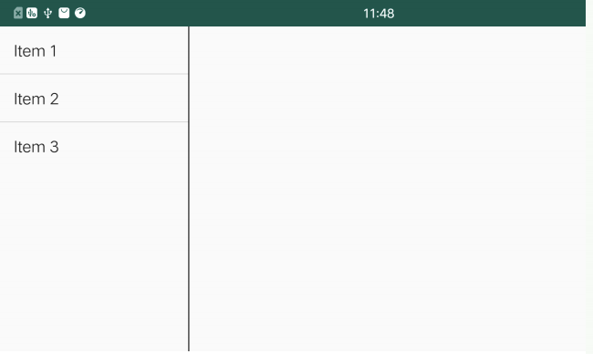
示例 - Master Detail
如何服用页面

Slide 22
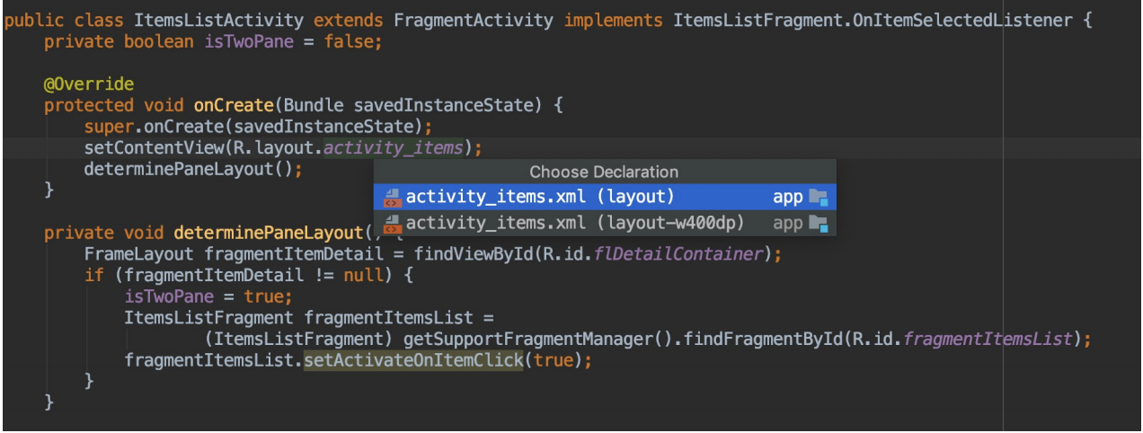
示例 - Master Detail
ItemListActivity
Notes:
f1，注意打开自动旋转

Slide 23
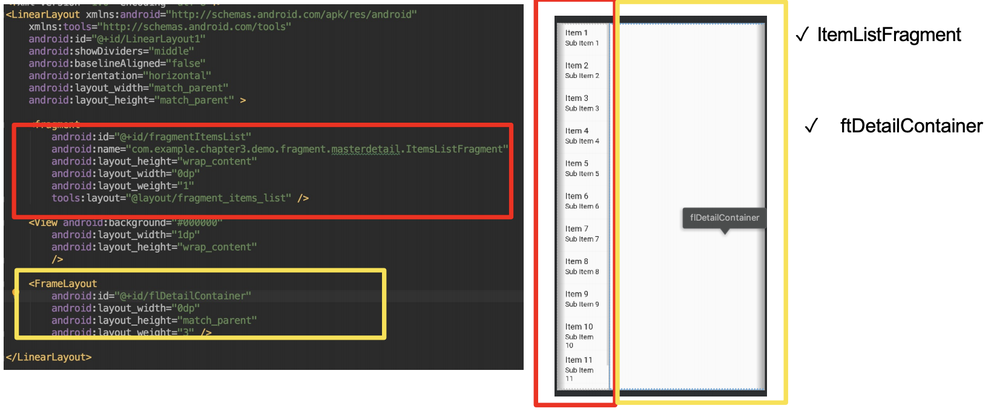
示例 - Master Detail
横竖屏不同界面-横屏
Notes:
f1，注意打开自动旋转

Slide 24
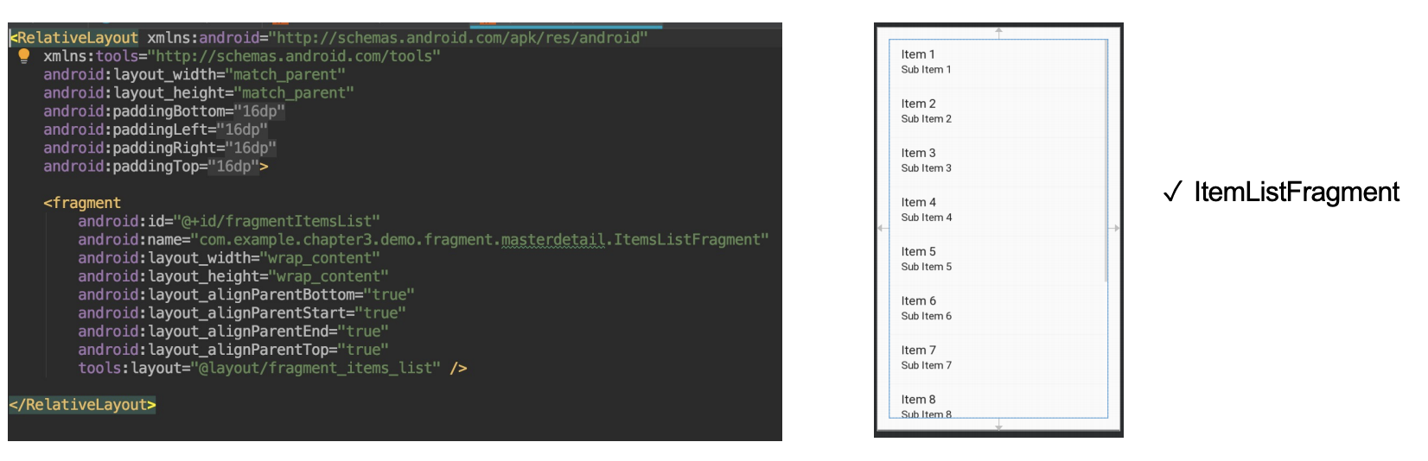
示例 - Master Detail
横竖屏不同界面-竖屏
Notes:
f1，注意打开自动旋转

Slide 25
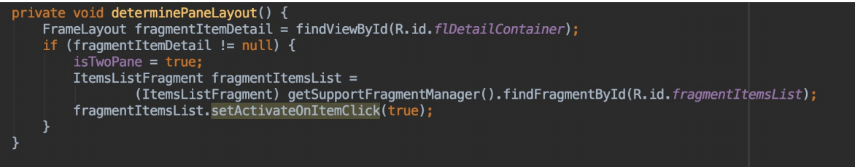
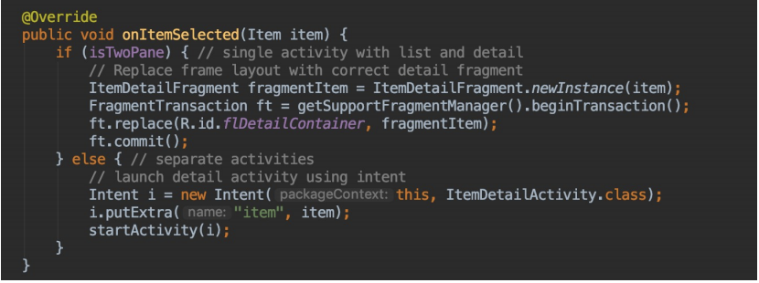
示例 - Master Detail
如何判断横竖屏
点击事件
Notes:
f1，注意打开自动旋转

Slide 26
Animation
动画的意义
让 View 动起来
让 Drawable 动起来

Slide 27
动画的意义
用户体验 (UX)
视觉反馈
Informative, Focused, Expressive
Notes:
https://airbnb.design/lottie/
https://material.io/design/motion/understanding-motion.html

Slide 28
动画的意义
用户体验 (UX)
视觉反馈
Informative, Focused, Expressive
Notes:
https://airbnb.design/lottie/
https://material.io/design/motion/understanding-motion.html

Slide 29
动画的意义
用户体验 (UX)
视觉反馈
Informative, Focused, Expressive
Notes:
https://airbnb.design/lottie/
https://material.io/design/motion/understanding-motion.html

Slide 30
View 相关动画
View Animation: android.view.animation
Property Animation: android.animation

Slide 31
示例 - PropertyAnimation, XML
// res/animator/fade.xml
<objectAnimator xmlns:android="http://schemas.android.com/apk/res/android" android:duration="1000" android:propertyName="alpha" android:valueTo="0.1f" />
// activity
Animator anim = AnimatorInflater.loadAnimator(activity, R.animator.fade); anim.setTarget(v); anim.start();
Notes:
a1/PropertyAnimations
https://developer.android.com/guide/topics/graphics/prop-animation

Slide 32
示例 - PropertyAnimation, Code
ObjectAnimator alphaAnimation = ObjectAnimator.ofFloat(alphaButton, View.ALPHA, 0); alphaAnimation.setRepeatCount(1); alphaAnimation.setRepeatMode(ValueAnimator.REVERSE);
alphaAnimation.start();
Notes:
https://developer.android.com/guide/topics/graphics/prop-animation

Slide 33
示例 - More Property
// translationX, translationY
ObjectAnimator transAnim = ObjectAnimator.ofFloat(translateButton, "translationX", 800);
<objectAnimator xmlns:android="http://schemas.android.com/apk/res/android" android:propertyName="translationX" android:duration="300" android:valueTo="800"/>
Notes:
https://developer.android.com/guide/topics/graphics/prop-animation

Slide 34
示例 - More Property
// rotation, rotationX, rotationY
ObjectAnimator rotateAnim = ObjectAnimator.ofFloat(rotateButton, “rotation”, 360);
<objectAnimator xmlns:android="http://schemas.android.com/apk/res/android" android:propertyName="rotation" android:valueFrom="0" android:duration="300" android:valueTo="360"/>
Notes:
https://developer.android.com/guide/topics/graphics/prop-animation

Slide 35
示例 - More Property
// scaleX, scaleY
PropertyValuesHolder pvhX = PropertyValuesHolder.ofFloat(View.SCALE_X, 2); PropertyValuesHolder pvhY = PropertyValuesHolder.ofFloat(View.SCALE_Y, 2); ObjectAnimator scaleAnim = ObjectAnimator.ofPropertyValuesHolder(scaleButton, pvhX, pvhY);
<set xmlns:android="http://schemas.android.com/apk/res/android"> <objectAnimator android:propertyName="scaleX" android:duration="300" android:valueTo="2"/> <objectAnimator android:propertyName="scaleY" android:duration="300" android:valueTo="2"/> </set>
Notes:
https://developer.android.com/guide/topics/graphics/prop-animation

Slide 36
示例- AnimatorSet
<set xmlns:android="http://schemas.android.com/apk/res/android" android:ordering="sequentially"> <objectAnimator android:propertyName="alpha" android:valueTo="0"/> <objectAnimator android:propertyName="translationX" android:valueTo="800"/> <objectAnimator android:propertyName="rotation" android:valueFrom="0" android:valueTo="360"/> <set> <objectAnimator android:propertyName="scaleX" android:valueTo="2"/> <objectAnimator android:propertyName="scaleY" android:valueTo="2"/> </set> </set>
Notes:
https://developer.android.com/guide/topics/graphics/prop-animation

Slide 37
示例- AnimatorSet
AnimatorSet setAnimation = new AnimatorSet(); setAnimation.play(translateAnimation).after(alphaAnimation).before(rotateAnimation); setAnimation.play(rotateAnimation).before(scaleAnimation);
setAnimation.playSequentially(alphaAnimation, translateAnimation, rotateAnimation, scaleAnimation);
setAnimation.playTogether(alphaAnimation, translateAnimation, rotateAnimation, scaleAnimation);
Notes:
https://developer.android.com/guide/topics/graphics/prop-animation

Slide 38
基本的类
Property
ObjectAnimator
AnimatorSet
Notes:
https://developer.android.com/guide/topics/graphics/prop-animation

Slide 39
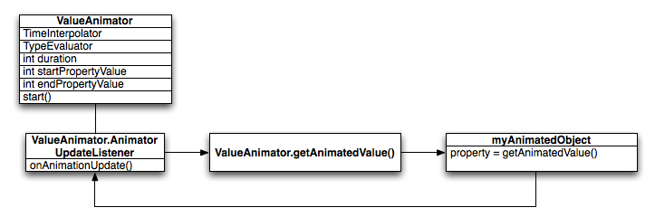
背后 - ValueAnimator
Notes:
https://developer.android.com/guide/topics/graphics/prop-animation

Slide 40
背后 - ValueAnimator
ValueAnimator animation = ValueAnimator.ofFloat(0f, 100f); animation.setDuration(1000);
animation.addUpdateListener(new ValueAnimator.AnimatorUpdateListener() { @Override public void onAnimationUpdate(ValueAnimator updatedAnimation) { float animatedValue = (float)updatedAnimation.getAnimatedValue(); textView.setTranslationX(animatedValue); } });
animation.start();
Notes:
https://developer.android.com/guide/topics/graphics/prop-animation

Slide 41
示例 - Crossfade
mLoadingView.animate() .alpha(0f) .setDuration(mShortAnimationDuration) .setListener(new AnimatorListenerAdapter() { @Override public void onAnimationEnd(Animator animation) { mLoadingView.setVisibility(View.GONE); } });

Slide 42
让 Drawable 动起来
AnimationDrawable
AnimatedVectorDrawable
Lottie

Slide 43
Demo - AnimationDrawable
// res/drawable/rocket.xml
<animation-list xmlns:android="http://schemas.android.com/apk/res/android" android:oneshot="true"> <item android:drawable="@drawable/rocket_thrust1" android:duration="200" /> <item android:drawable="@drawable/rocket_thrust2" android:duration="200" /> <item android:drawable="@drawable/rocket_thrust3" android:duration="200" /> </animation-list>
// activity
ImageView rocketImage = (ImageView) findViewById(R.id.rocket_image); rocketImage.setBackgroundResource(R.drawable.rocket_thrust); rocketAnimation = (AnimationDrawable) rocketImage.getBackground();
rocketAnimation.start();

Slide 44
Demo - Lottie
<com.airbnb.lottie.LottieAnimationView android:id="@+id/animation_view" android:layout_width="wrap_content" android:layout_height="wrap_content" app:lottie_rawRes="@raw/hello_world" // from res/raw
//or app:lottie_fileName="hello_world.json" // from assets/ app:lottie_loop="true" app:lottie_autoPlay="true" /> 使用LottieAnimationView， LottieAnimationView 直接继承自 AppCompatImageView

Slide 45
Demo - Lottie
如果不想用 xml 实现，可以通过代码来实现，可以直接加载本地动画资源，也
可以从网络请求加载动画。
如下，从 res/raw 或 assets/ 加载动画资源：
LottieAnimationView animationView = ...
animationView.setAnimation(R.raw.hello_world);
// or
animationView.setAnimation(R.raw.hello_world.json);
animationView.playAnimation();

Slide 46
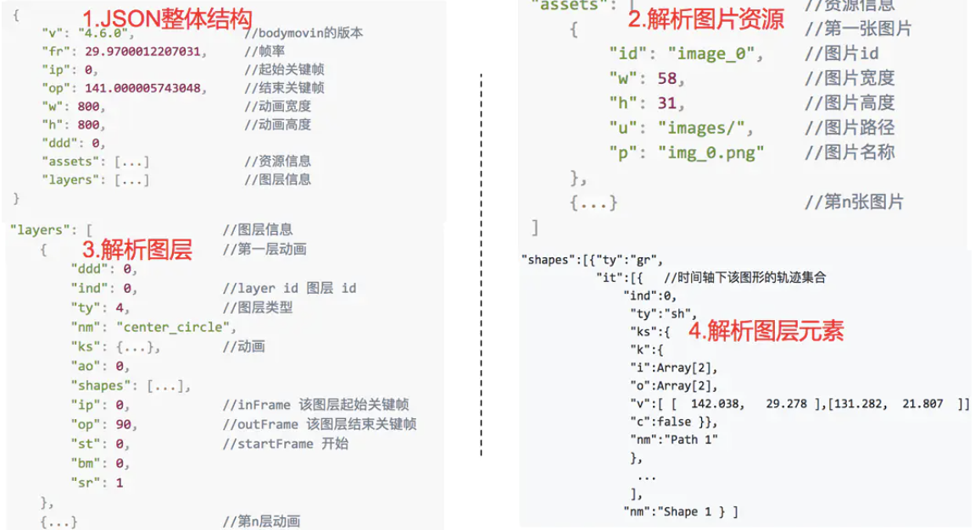
Demo - Lottie
结构层：可以读取到动画画布的宽高，帧数，背景色，时间，起始关键帧，结束帧等信息。 asset：图片资源信息集合，这里放置的是 制作动画时引用的图片资源。 layers：图层集合，这里可以获取到多少图层，每个图层的开始帧 结束帧等。 shapes：元素集合，可以获取到每个图层都包含多个动画元素。

Slide 47
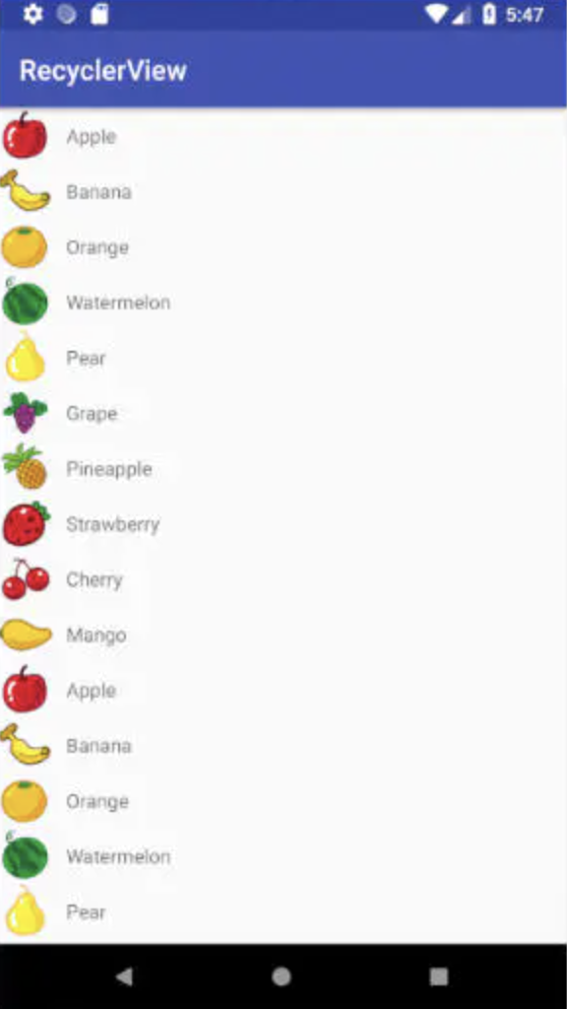
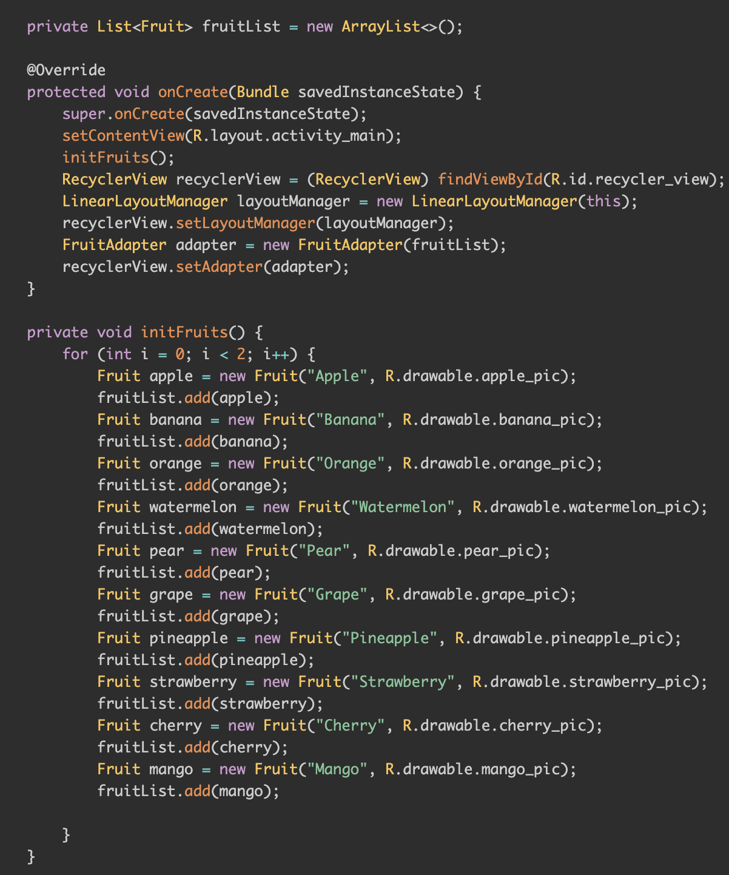
扩展RecyclerView – 列表的横纵向滚动

Slide 48
小练习
利用ViewPagert+Fragment写出一个类似页面
每个页面（fragment）中演练一种动画、
页面中增加RecyclerView的使用有加分

Slide 49

THANKS

